Slide 1
Lead Score Case Study
Submitted BY
Bijay Khanal

Slide 2
Lead Score Case Study for X Education
Problem Statement :
An education company named X Education sells online courses to industry professionals. The company markets its courses on several websites and search engines like Google.
Once the people land on the website, they might browse the courses or fill up a form for the course or watch some videos. When these people fill up a form providing their email address or phone number, they are classified to be a lead. Moreover, the company also gets leads through past referrals.
Once these leads are acquired, employees from the sales team start making calls, writing emails, etc. Through this process, some of the leads get converted while most do not. The typical lead conversion rate at X education is around 30%.
Business Goal:
X Education needs help in selecting the most promising leads, i.e. the leads that are most likely to convert into paying customers.
The company needs a model wherein you a lead score is assigned to each of the leads such that the customers with higher lead score have a higher conversion chance and the customers with lower lead score have a lower conversion chance.
The CEO, in particular, has given a ballpark of the target lead conversion rate to be around 80%.

Slide 3
Strategy
Source the data for analysis
Clean and prepare the data
Exploratory Data Analysis.
Feature Scaling
Splitting the data into Test and Train dataset.
Building a logistic Regression model and calculate Lead Score.
Evaluating the model by using different metrics -Specificity and Sensitivity or Precision and Recall.
Applying the best model in Test data based on the Sensitivity and Specificity Metrics.

Slide 4
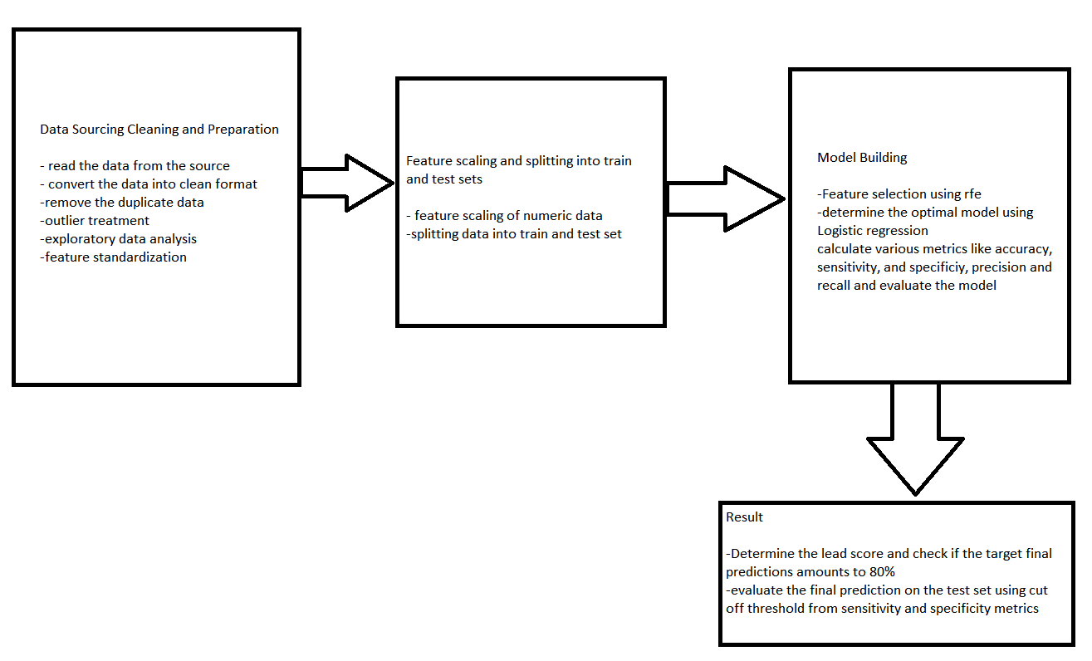

Slide 5
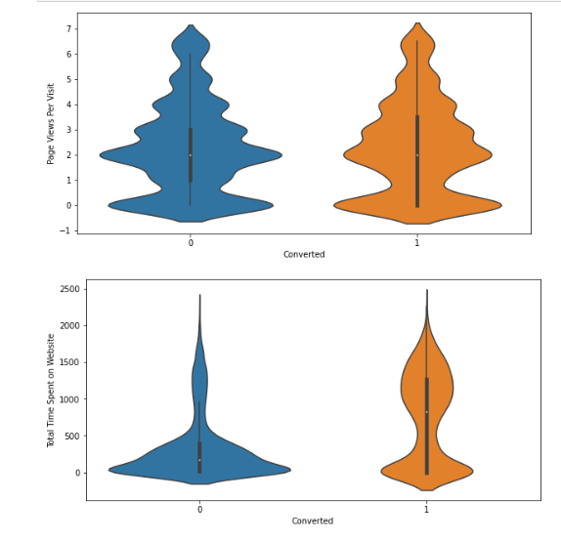
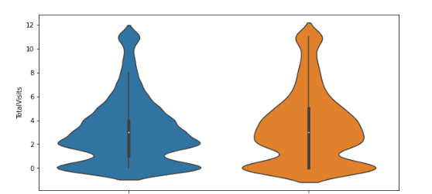
Exploratory data analaysis The conversion rates for Total Visits Total time spent on website and Page Views per visit were higher.
The conversion rates for the TotalVisits
Time spent on website and Page views
Per visit are high

Slide 6
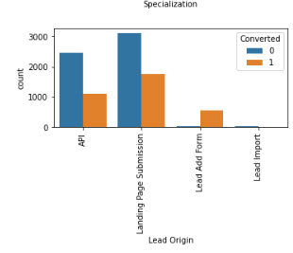
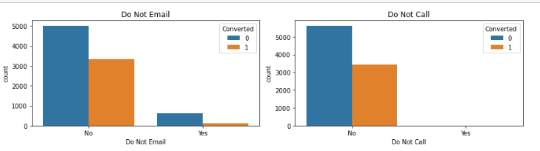
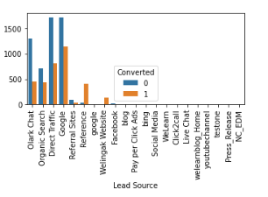
In lead origin Landing page submission the highest conversion occurred
In emails sent and calls made also highest conversion occurred
Lead source Google has maximum conversion

Slide 7
Variables Impacting the Conversion Rate
Do not Email
Total Time Spent on Website
Lead Origin_Landing Page Submission
Lead Origin_Lead Add Form
Lead Source_Olark Chat
Lead Source_Reference
Lead Source_Welingak Website
Last Activity_Email Opened
Last Activity_Olark Chat Conversation
Last Activity_Other_Activity
Last Activity_SMS Sent
Last Activity_Unreachable
Last Activity_Unsubscribed
Specialization_Others
What is your current occupation_Housewife
What is your current occupation_Student
What is your current occupation_Unemployed
What is your current occupation_Working Professional

Slide 8
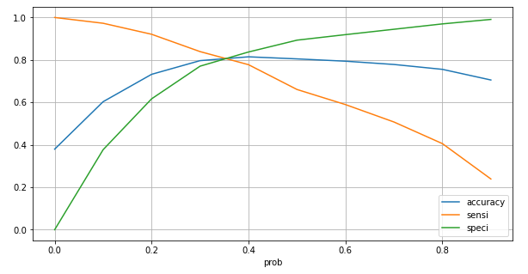
Model Evaluation -Sensitivity and Specificity on Train Data Set
This graph illustrates an optimal cutoff of 0.34 depending on the accuracy, sensitivity and specificity
The confusion matrix is
[[3607, 896],
[ 508, 2248]]
Train Data Accuracy :80.49 %
Train Data Sensitivity :81.57 %
Train Data Specificity :80.1 %
Train Data F1 Score :0.72

Slide 9
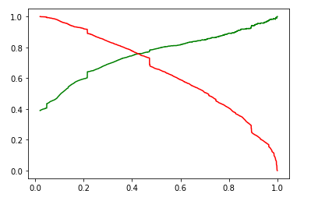
Model Evaluation-Precision and Recall on Train Dataset
Precision : 79.10%
Recall : 66.07%

Slide 10
Model Evaluation –Sensitivity and Specificity on Test Dataset
Confusion matrix is
[[928, 208],
[155, 524]]
Test Data Accuracy : 80.0 %
Test Data Sensitivity : 81.57 %
Test Data Specificity : 80.1 %
Test Data F1 Score : 0.74
Precision : 71.58%
Recall: 77.17%

Slide 11
Conclusion
While we have checked both Sensitivity-Specificity as well as Precision and Recall Metrics, we have considered the optimal cut off based on Sensitivity and Specificity for calculating the final prediction. –
Accuracy, Sensitivity and Specificity values of test set are around 80%, 81% and 80% which are approximately closer to the respective values calculated using trained set.
With insights from data, Team will be able to design a model to share lead Score , which will help sales team to target hot leads & convert them into Customers. Table UI is made simple to make sure teams works efficenctly & improves the sales.
Based on the absolute coefficient values the top 3 variables are:
Lead Origin_Lead Add Form
Lead Source_Welingak Website
Last Activity_Other_Activity Hence overall this model seems to be good.

